Slide 1
Using Python and R Interactively
Peter Kowalchuk
PyHou Meetup
February 2019

Slide 2
3 ways to interactively work with Python and R
Rstudio
Reticulate
Jupyter
RPY2
Databricks
SparkR + %Python magic

Slide 3

RStudio
install.packages("reticulate")

Slide 4
RStudio
1-reticulate
Moving variables between R and Python
R and Python chunks
Python functions within R
2-pythonversions
Managing python versions
3-usecase
When would I need this?

Slide 5

Jupyter
conda install rpy2

Slide 6
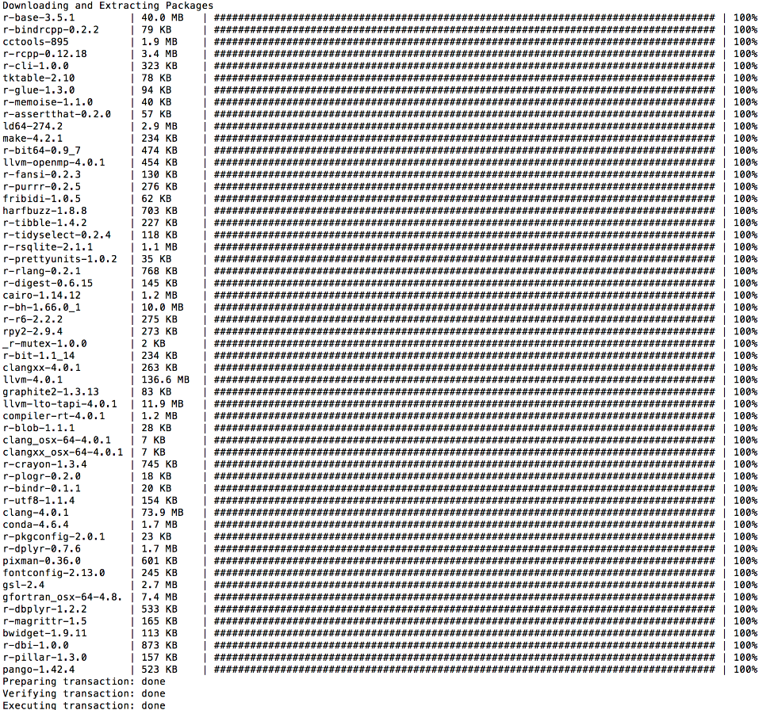
Jupyter

Slide 7
Jupyter
conda install tzlocal

Slide 8
Jupyter
Python and R cells

Slide 9

Databricks
Install SparkR library in cluster

Slide 10


Databricks
Temp Databricks dataframe used to move data between Python and R
R
Python

